Slide 1






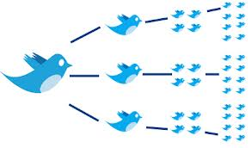



Social Media Analytics Community Detection Bi-partite Networks Cliques and cores MSBA, 14th Feb, 2022
Dr. Anitesh Barua
David Bruton Jr. Centennial Chair Professor of Business
Distinguished Fellow, INFORMS Information Systems Society
University of Texas Distinguished Teaching Professor
Associate Director, Center for Research in e-Commerce
McCombs School of Business, University of Texas at Austin
Email: aniteshb@gmail.com

Slide 2
Community Detection: Why Bother?
Detecting networks of fraudulent/rogue websites
Many use JavaScript redirects to link to each other to avoid detection through scraping
Estimating unknown features of users in social networks
Clustering similar users together
Enhance meaningful communication
Can be a network of products
E.g., to show the effect of recommender systems on competition
Show that a “community” has products from very different parts of the demand curve
https://joshbarua2002.medium.com/who-is-your-competitor-in-the-era-of-the-long-tail-d0ac24fedde8

Slide 3
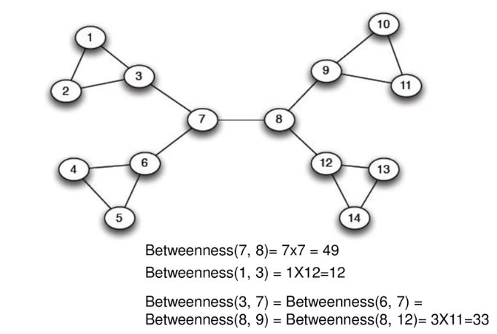
How to Detect Communities Within Networks
Common for uni-partite (1-mode) networks
Girvan-Newman algorithm (divisive algorithm)
Calculate betweenness centrality of “links”
How?
(i) Cut the link with highest betweenness centrality
(ii) Recalculate betweenness for all remaining links
(iii) Cut the link with highest betweenness
(iv) Repeat (ii) and (iii) until the network disintegrates into disjoint parts
Excellent article: https://www.analyticsvidhya.com/blog/2020/04/community-detection-graphs-networks/

Slide 4
Types of Networks
Uni-partite, bi-partite, tri-partite (or multi-partite) networks
Also called 1-mode, 2-mode, etc.
Uni-partite: Only one type of nodes (e.g., people)
Bi-partite: E.g., authors & articles, actors & movies, FB users and their group memberships, etc.

Slide 5
Bi-partite Networks: An Example
1
2
3
4
Authors
A
B
C
Articles
No connections between nodes of the same type
Can we reduce this network to 1-mode? How?

Slide 6
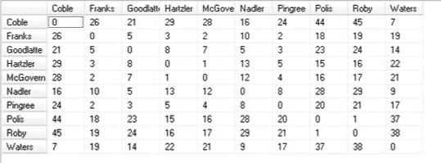
2-mode to 1-mode Networks
2-mode: Congress(wo)man & age
How to reduce to 1-mode (person-to-person)?
Source: http://www.umasocialmedia.com/socialnetworks/networks-lecture-13-qap-correlation/

Slide 7
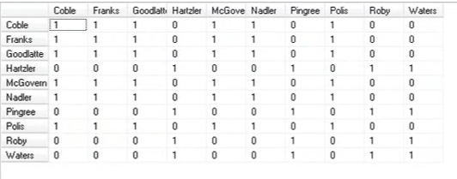
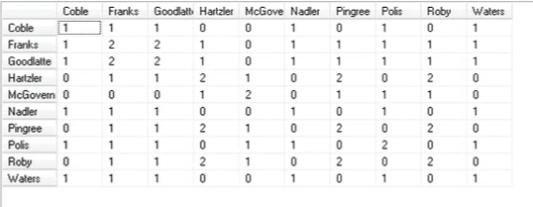
Gender & Committees
Source: http://www.umasocialmedia.com/socialnetworks/networks-lecture-13-qap-correlation/

Slide 8
Communities in Bi-partite Networks
Densely linked parts of a bi-partite network
constitute communities
E.g., people’s memberships in a set of activities
Concerts
Music lessons
Woodworking
Painting

Slide 9
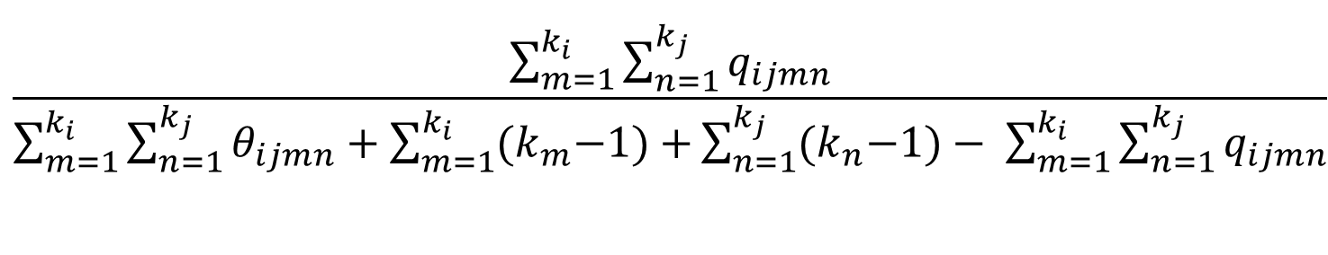
Detecting Communities in Bi-partite Networks
r
i
k_{m} & k_{n} degrees of m & n
q
m
p
n
j
For a pair of nodes, i and j, let m and n be neighbors of i and j respectively
q_{ijmn} = 1 if m and n are connected, 0 otherwise. θ_{ijmn} has the opposite definition.
Edge clustering coefficient C(i, j) =
# squares that currently include i-j / possible # squares that include i-j
$$\frac{\sum_{m=1}^{k_{i}}{\sum_{n=1}^{k_{j}}{q_{ijmn}}}}{\sum_{m=1}^{k_{i}}{\sum_{n=1}^{k_{j}}{θ_{ijmn}}}+\sum_{m=1}^{k_{i}}{{(k}_{m}−1)+}\sum_{n=1}^{k_{j}}{{(k}_{n}−1)− \sum_{m=1}^{k_{i}}{\sum_{n=1}^{k_{j}}{q_{ijmn}}}}}$$
Source: P. Zhang et al. 2013

Slide 10
Detecting Communities in Bi-Partite Networks
Start dropping links with smallest clustering coefficient
Network will start splitting up
But much easier to first divide into two 1-mode networks
The apply G-N or other algorithms to detect communities within 1-mode networks
We do lose some information
Example: https://medium.com/@adibarua2002/creating-smarter-online-communities-with-nlp-and-network-analytics-147810d3cee5?source=friends_link&sk=d7f5809dfa0e7cc774448615e9287de5

Slide 11
Sample Project on Bi-Partite Networks
Readers and books
How to create a manageable network
Compare recommendations based on
Book-to-book similarity (uni-partite)
Person-to-person and then recommending books that similar readers have read but not the focal reader.
Does the second method provide more variety?

Slide 12
Identifying Trolls, Spammers and Fake Content Creators
Trolls, spammers, bots
Creators of fake content
Is there anything common across them?
Was not too difficult to detect fake content (e.g., reviews) from content in the past
Why is it difficult to detect now?
Network analytics may help

Slide 13
They Come in Many Flavors
~ 19 million bot accounts tweeted in support of either Trump or Clinton in 2016
> 1,000 paid Russian trolls spread “fake news” on Hillary Clinton
CNN mobile app received 100s of thousands of 1-star reviews after the network’s treatment of a certain Reddit user
The Boca Raton Resort hotel got a huge number of negative reviews (1000s) after a Youtube star angry at his treatment rallied his fanbase to retaliate online
But may be more connected than regular users!

Slide 14
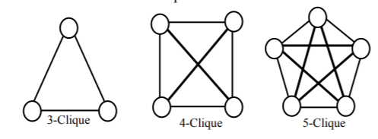
Of “Cliques” and “Cores”
Definition of an n-clique?
What is the significance of a clique?
A large network will consist of many cliques
Often the largest clique is of interest

Slide 15
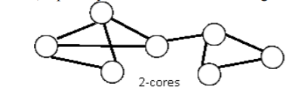
K-core
A 2-core
Definition of a k-core?
What is the significance?
Largest k for a network is of special interest

Slide 16
Hypotheses (Can be Tested)
Spammers have larger k-cores than non-spammers
Spammers have larger n-cliques than non-spammers
Spammers have higher network density

Slide 17
Calculating Cliques and k-cores
Lots of python code available on GitHub and other sites
https://www.kaggle.com/mayeesha/network-analysis-for-dummies-stackoverflow-data
https://s3.amazonaws.com/assets.datacamp.com/production/course_3286/slides/ch3_slides.pdf
https://towardsdatascience.com/intro-to-graphs-in-python-using-networkx-cfc84d1df31f
Maximum value of k in k-cores within a network
https://github.com/chibuta/k-core-subgraph

Slide 18
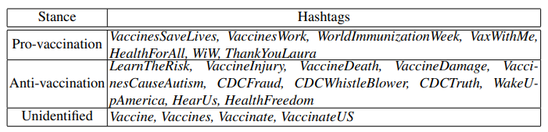
Data Issues
If collecting primary data
Twitter → Find out important hashtags (e.g., anti- vs. pro-vaxxer, anti-climate change vs. pro)
Other sources (like discussion forum): Separate source and target during scraping.
E.g., creator of an original post in one column
Person (or people) commenting in another column
Many useful sources of archived network data
https://github.com/benedekrozemberczki/datasets
Other sources on GitHub, some on Kaggle

